Slide 1
Mrs. Howarth’s Fifth- Grade Class

Slide 2
All About Me
My background
I live in Chino Hills & my kids attend Chino Hills High School.
I am from Southern California.
My experience
I’ve been teaching for 25 years.
I have also taught kindergarten, 3rd, 4th and 6th grades.

Slide 3
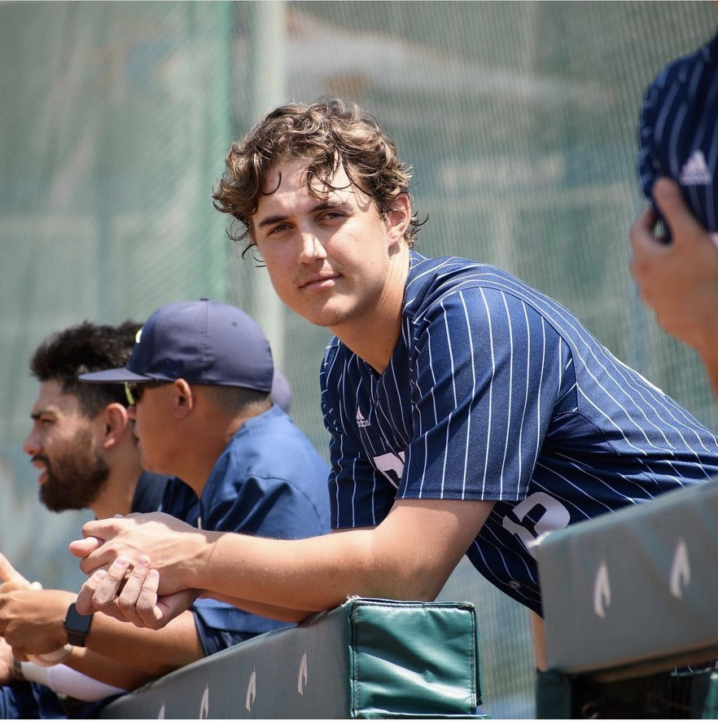
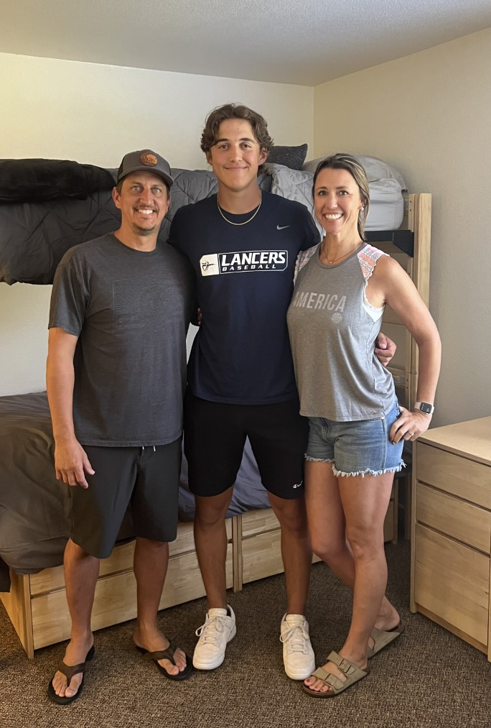
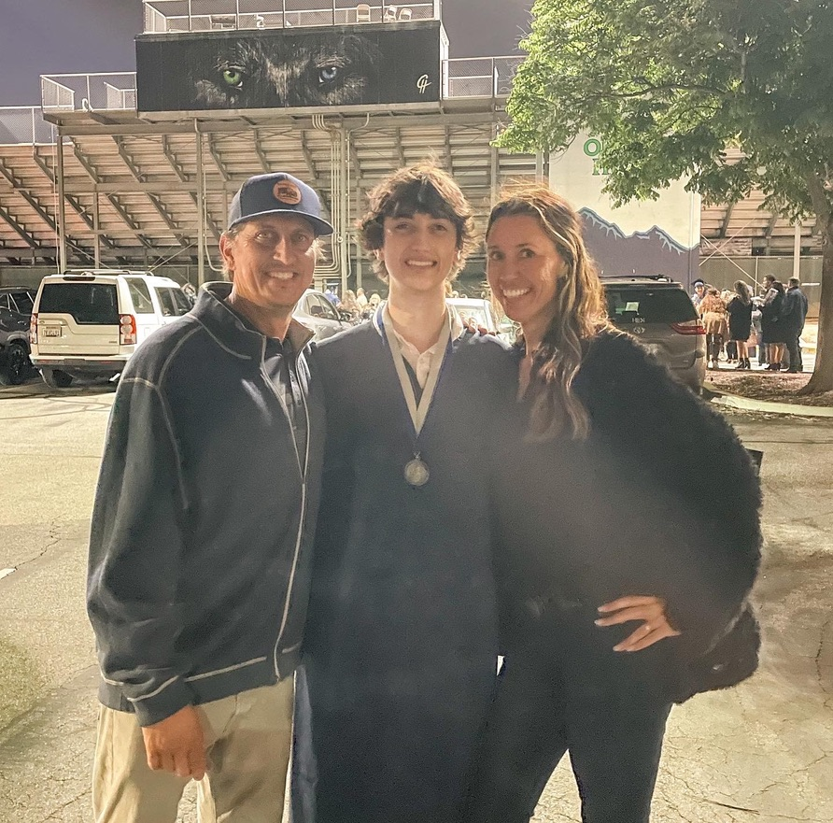
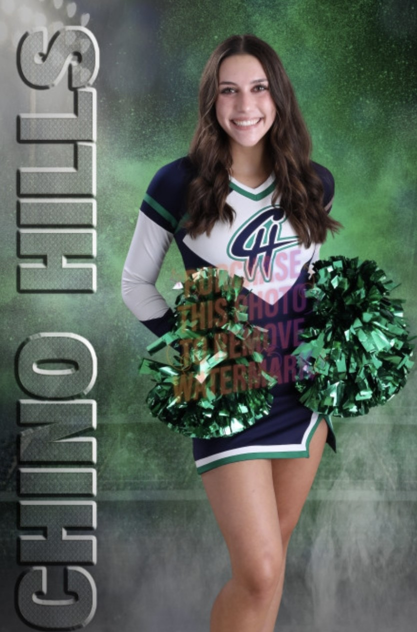
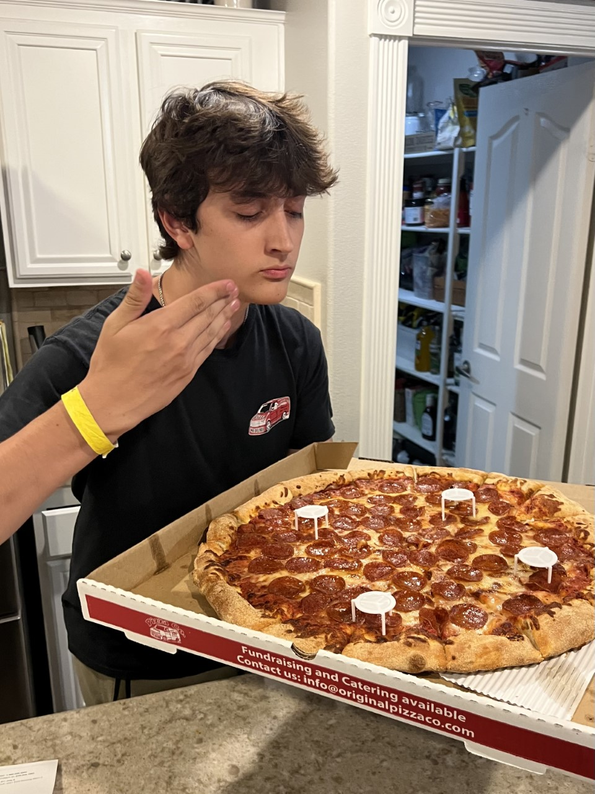
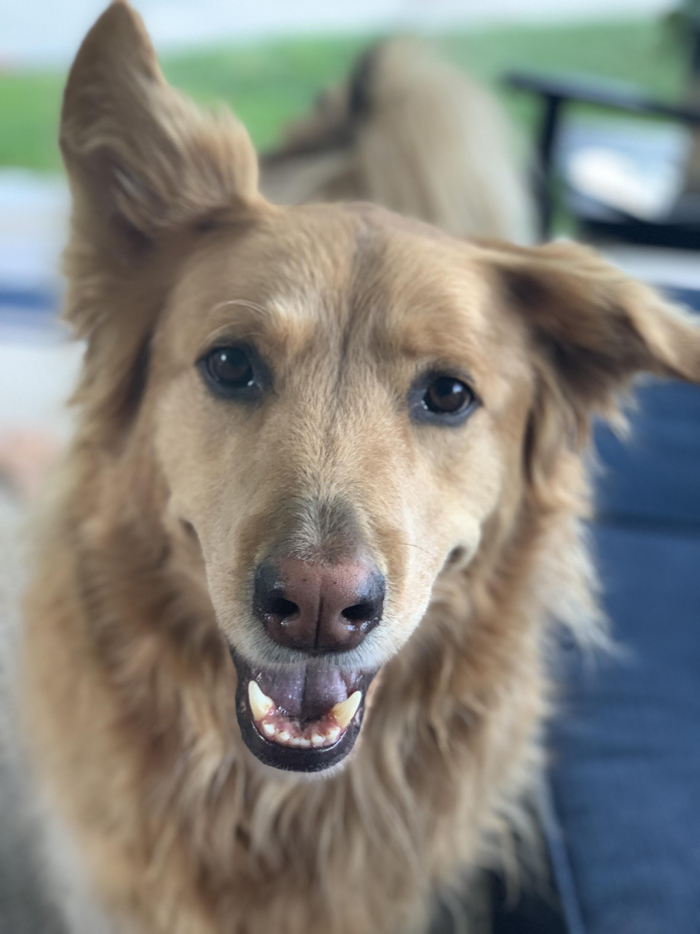
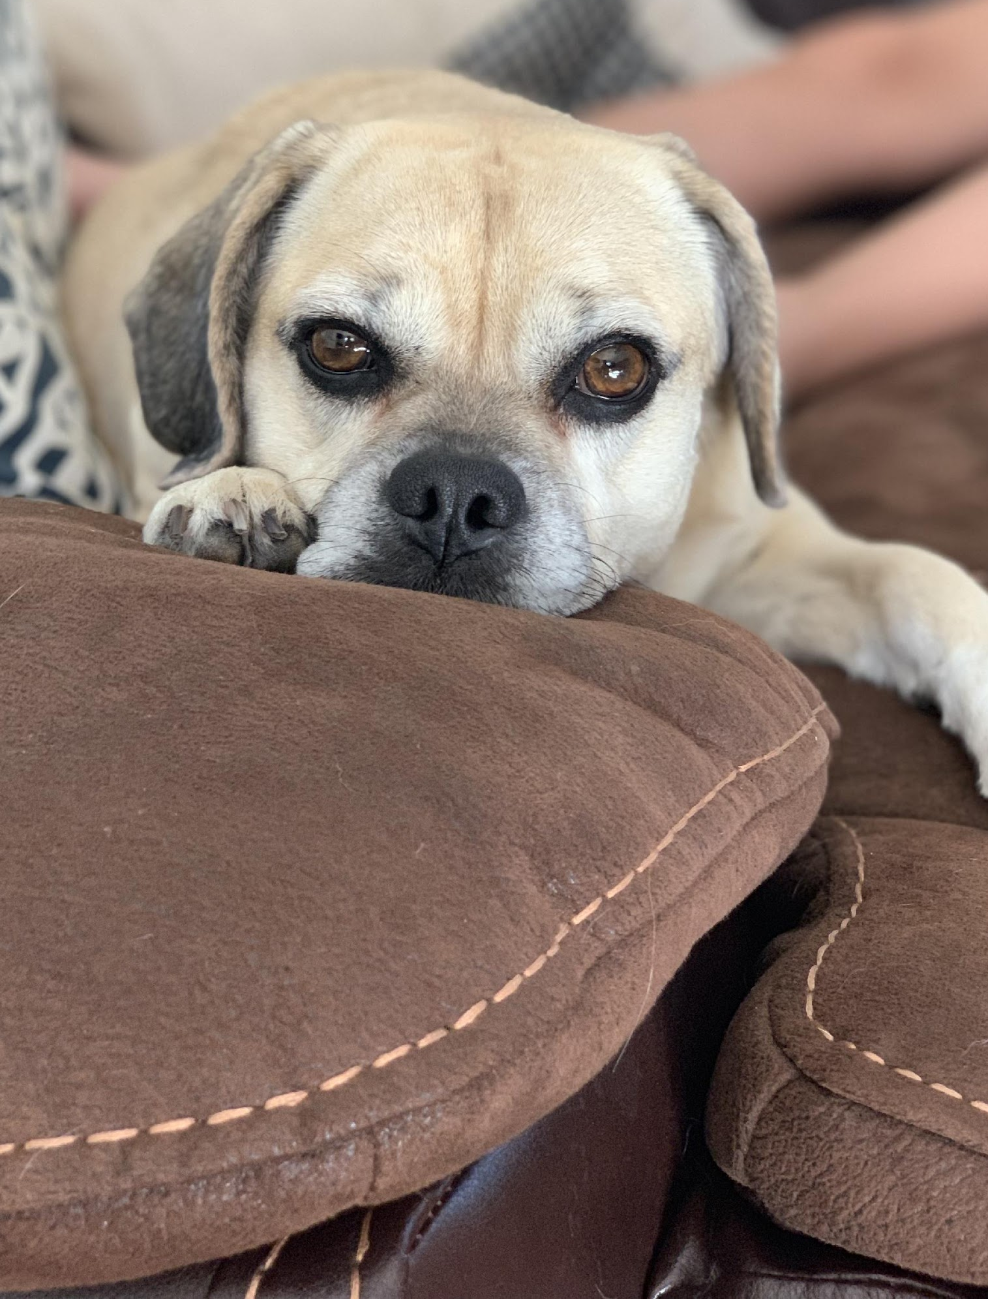
My Family
My husband
Jeff
My children
Cole, Adam, & Makenna
Our pets
Alvin and Cali

Slide 4
Contact Me!
E-mail: Stacy_Howarth@chino.k12.ca.us
Remind or Parent Square App
Phone Wickman: (909) 393-3774

Slide 5
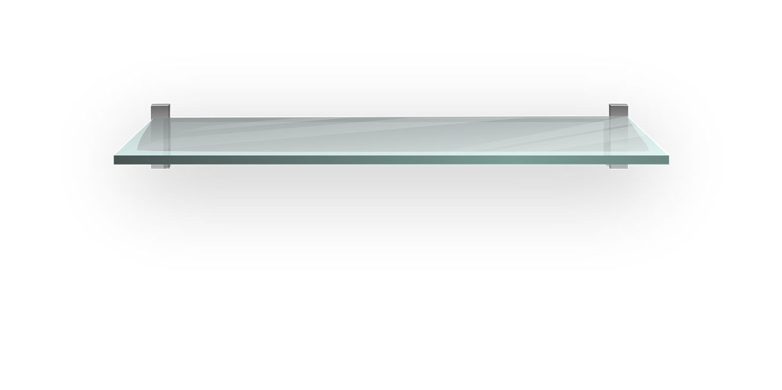
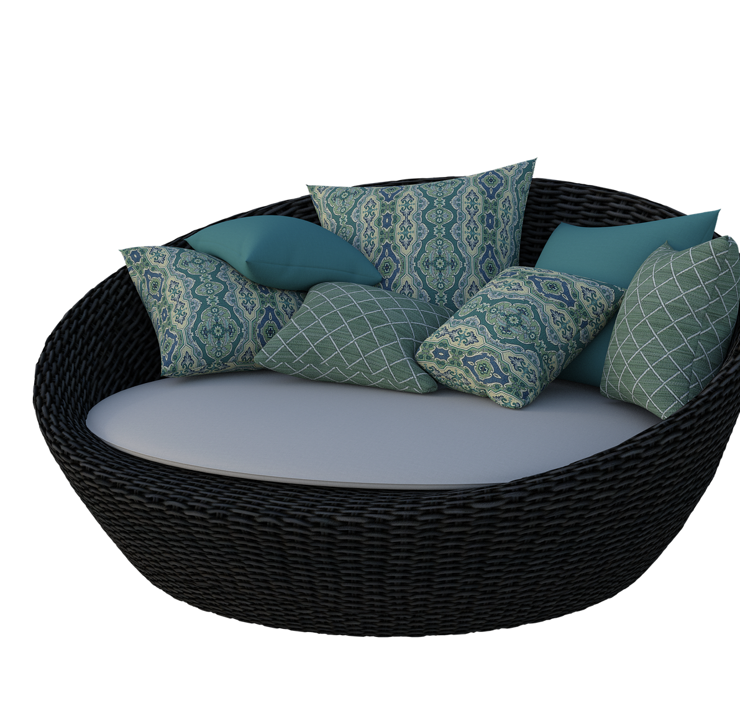
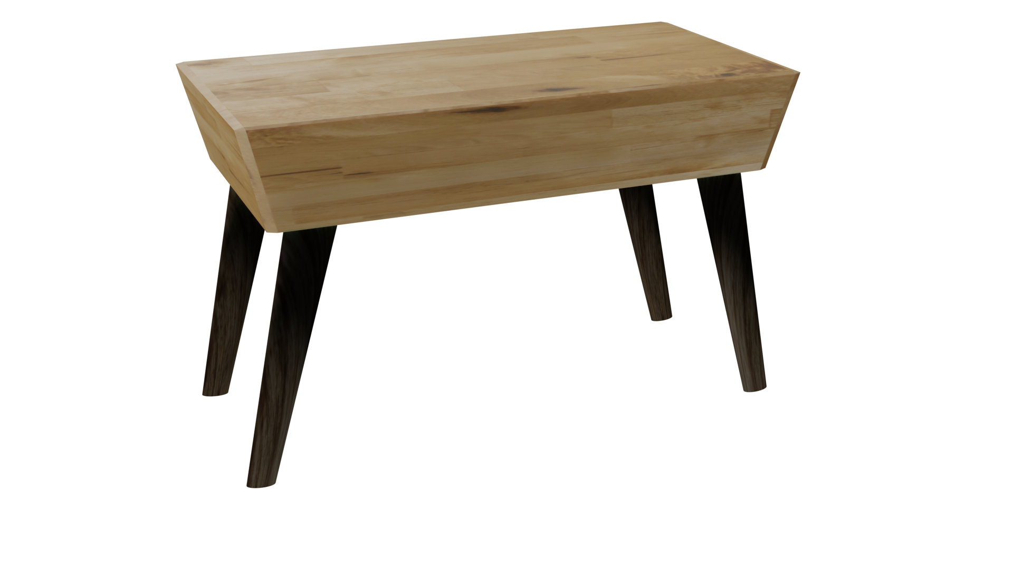
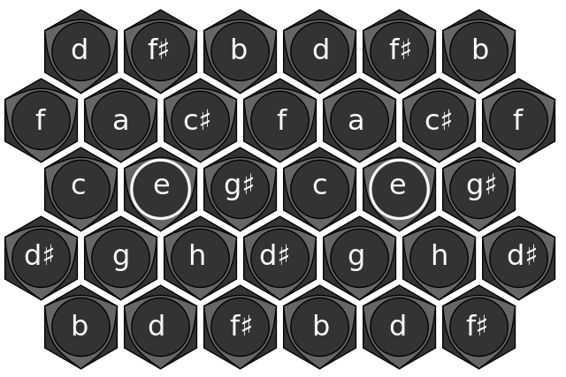
Regular School Days
7:50 Morning Work
8:15 Writing
8:50 P.E.
9:15 ELA
10:40 Recess
10:53 Math
12:10 Lunch
12:50 Reading/AR
1:05 Science/Social Studies
2:00 Intervention/Wildcat Time
*Minimum Day on Thursday

Slide 6
Reading
Our class will be using a reading program published by McGraw Hill called Wonders as well as reading several novels. Our focus will be on the Essential Standards.
*AR

Slide 7
Writing
We will focus on writing narratives, informational pieces, and opinion pieces.

Slide 8
Math
Savvas is our math text.
There is a link from ClassLink to the web page.
We will also have access to leveled math on IXL

Slide 10
Early People of America
Colonies
Revolutionary War
The Constitution
Western Expansion
President Report
Living History Museum
Field Trip in March to Riley’s Farm

Slide 11
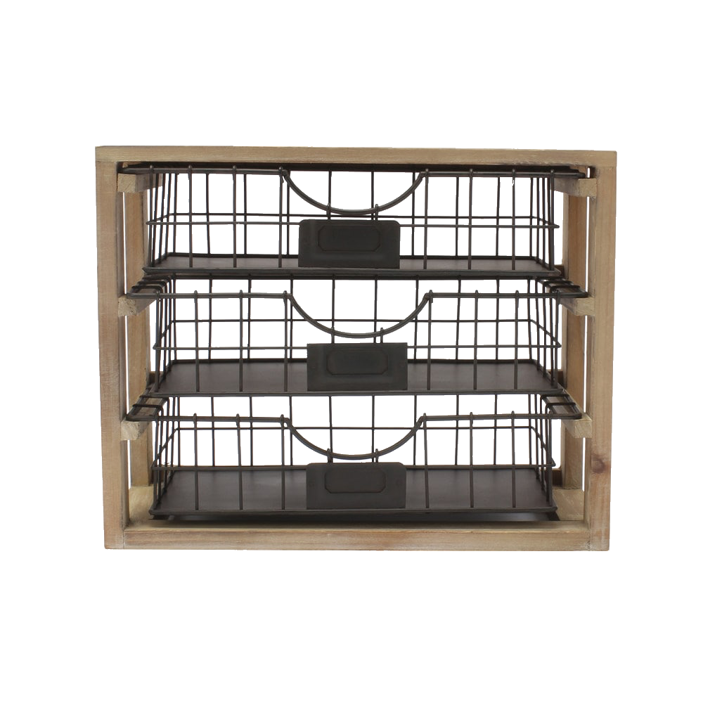
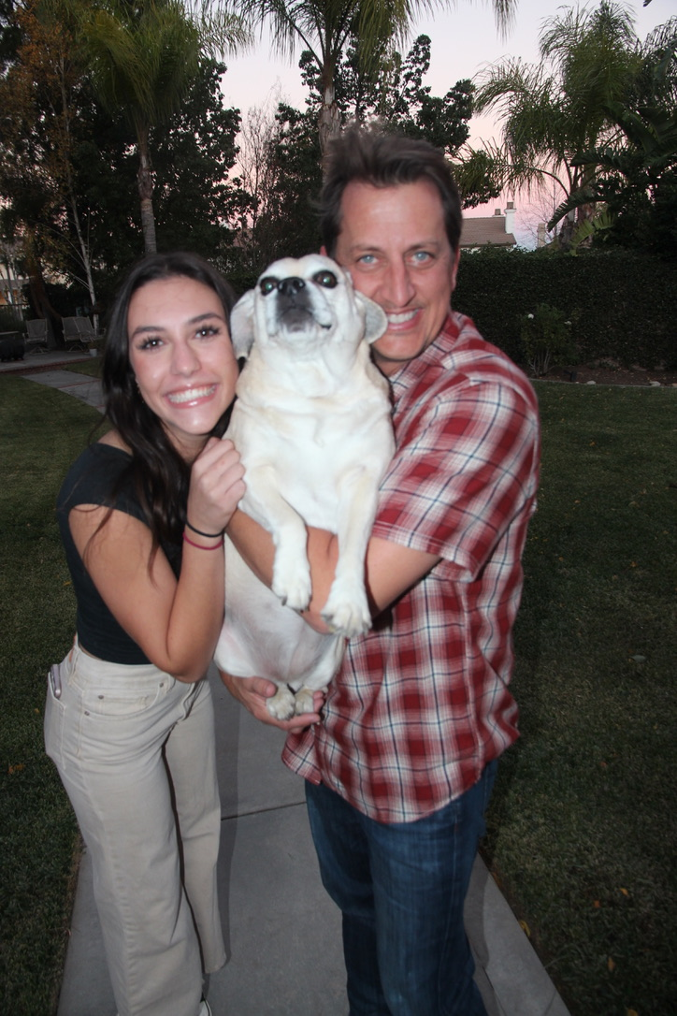
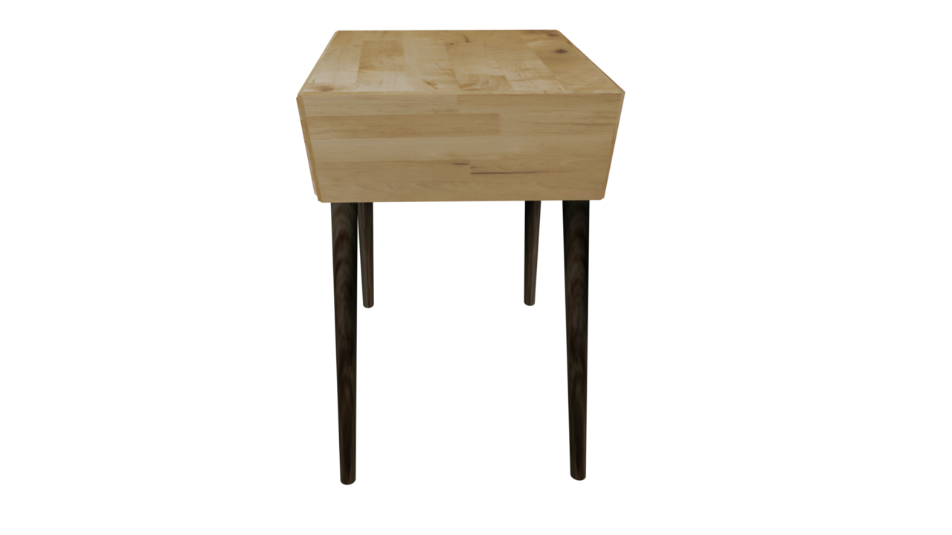
School Activities!
Debate: Begins 9/6
Band: classes start 8/28
Coding: instruction starts 9/5
Art Pals Monthly

Slide 12
Homework
Students will be encouraged to finish any unfinished work from class and in Google Classroom
30 minutes of reading daily is our focus/Accelerated Reader
IXL for Math extension
Birthdays:
If you would like to celebrate your child’s birthday with the class, you may send in treats for each student in the class. The teacher will distribute the goodie bags or treats. Please only use treats that do not contain nuts.
Class Celebrations:
Each classroom will have a PTO Room Parent that will assist with class celebrations. If you would like to volunteer to help, please sign up or send me a message.

Slide 13
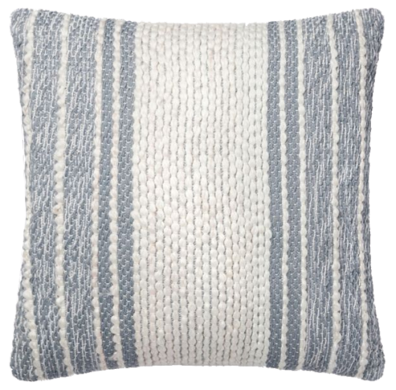
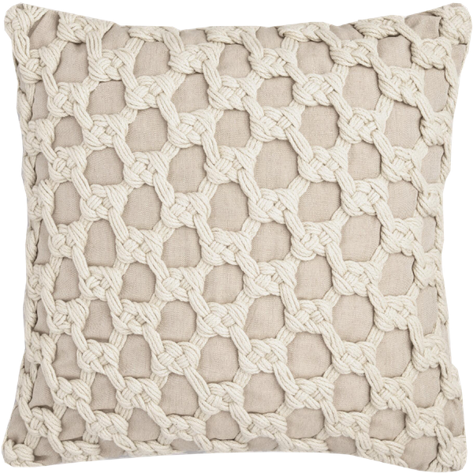
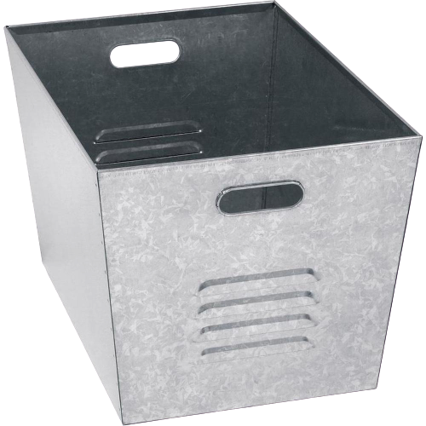
Feedback
Wonders Language Arts &, Mathematics (Savvas Easy Bridge),will provide instant feedback on assignments and assessments. Work completed and submitted on Google Classroom will be assessed by the teacher.
Grades are available on Google Classroom.

Slide 14
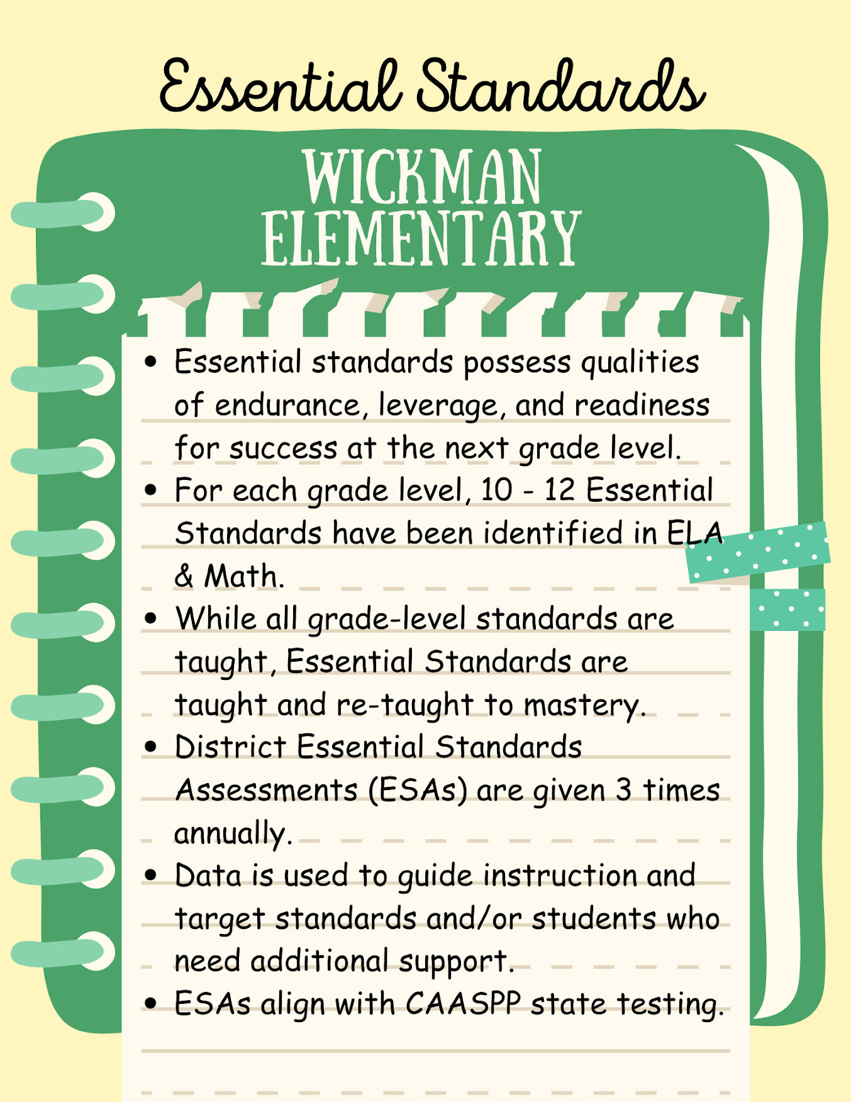

Slide 15
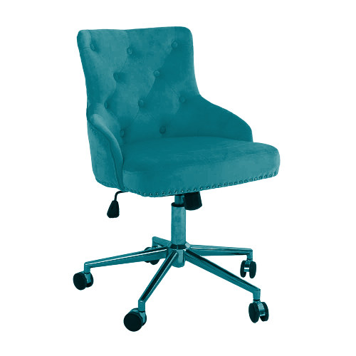
Grading
Coding Every 2 weeks
After School Programs for STEM and GATE
•4 – Excelling Student is consistently meeting the grade level performance standards expected at this point of the year with independence and can extend the grade level standards
•3 – Achieving Student is consistently meeting the grade level performance standards expected at this point of the year
•2 – Progressing Student is partially meeting the grade level performance standards expected at this point of the year.
•1 – Beginning student is not yet meeting grade level performance standards expected at this point of the year.
s

Slide 17
 | Positive Expectations | Always Be Responsible | Work and Play Safely | Show Respect
Entering the Classroom/Morning Meeting | Quietly enter the room Listen carefully to all announcements Politely greet your teacher | Begin working without a reminder Take out all necessary materials | - Cell phone is off and in your backpack Keep your hands to yourself | Kindly remind others of our expectations Listen to your classmates when they are speaking
During the lesson/instruction | Stay positive Listen to classmates comments and questions Raise your hand and wait to be called upon Talk when appropriate | Be an active listener Ask questions to gain understanding Stay on task Complete classwork assigned | Keep your hands to yourself Stay seated while others are talking | Be supportive of others questions and comments Provide encouragement to those struggling to understand
Group and Independent work | Only the person you’re talking to should hear you Raise your hand to ask questions Help your classmates without giving answers | Ask questions to gain understanding Use all time wisely Complete assignments using your best effort | - Be honest about your understanding Complete your own work | Be aware of your partners level of understanding Provide support and encouragement to others
Computers | Quietly get your assigned computer Log off, and plug in your computer in the correct spot | Make sure work is saved before logging off Only have tabs open that pertain to the instruction from your teacher | Use the computer for the assigned activity Use academic honesty when completing projects Please keep your user name and password private Do not allow anyone to use your chrome book | Help those that need it when technology problems arise
Wildcat Time | Quietly complete tasks Stay in your seat unless given permission to be out of it | - Use this time wisely Organize your things | Work independently without distracting others | Kindly remind others of our expectations
Cleaning up/Leaving the room | Leave your area clean Teacher will dismiss you, not the bell | - Return all supplies to where they belong Place your work in the appropriate place Write homework in our agenda | Make sure your work area is clean and free of loose items. Push in your chair. Walk patiently out the door | Check to see if others have taken all their belongings Kindly remind others of our expectations

Slide 18
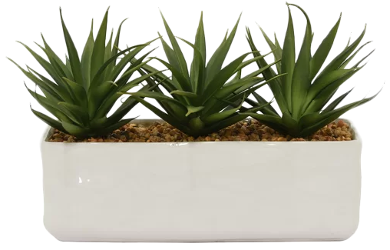
YOU MATTER
rewards/Incentives
Winner Tickets/Drawings
Student Point Ledger
and Bi-Weekly student Auction
donations

Slide 19
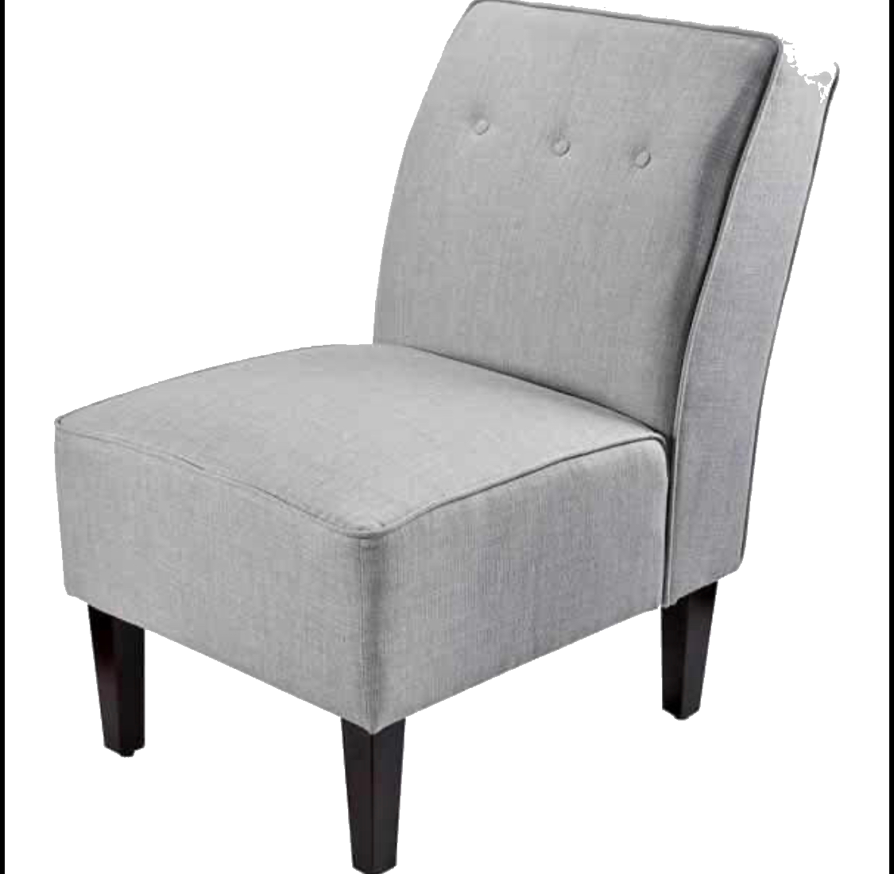
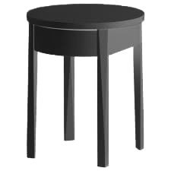
Virtual or Live Parent Teacher
Conferences
Conference Dates Monday, 9/25-9/29
*using sign up link sent through Remind App

Slide 20
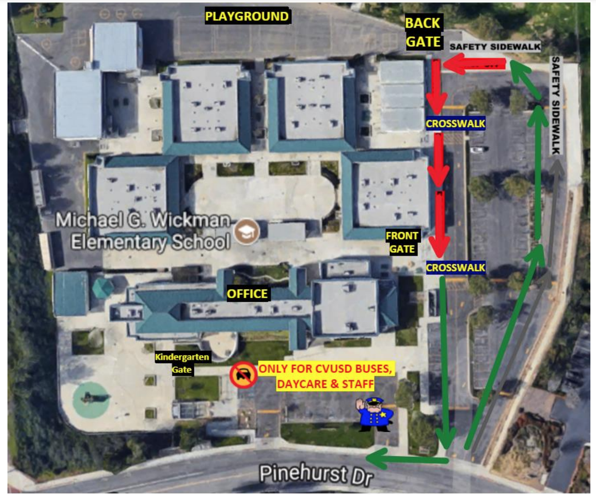

Slide 21
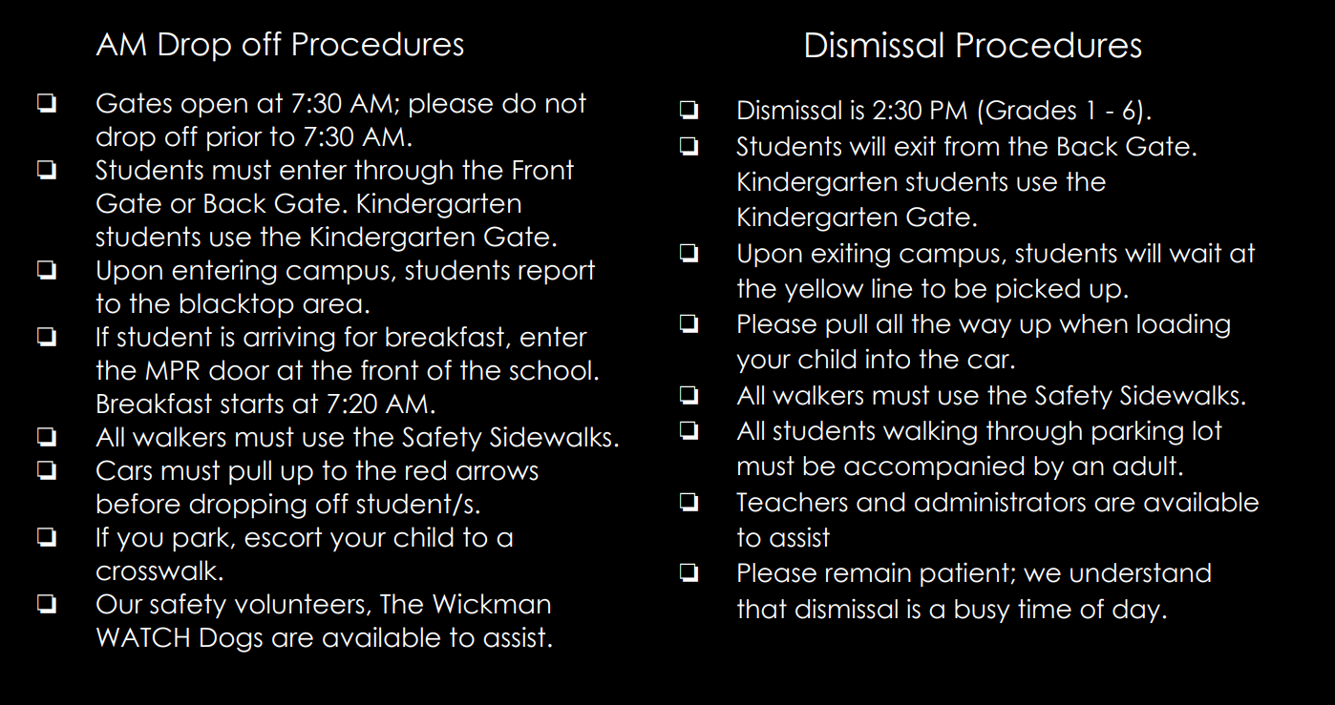

Slide 22
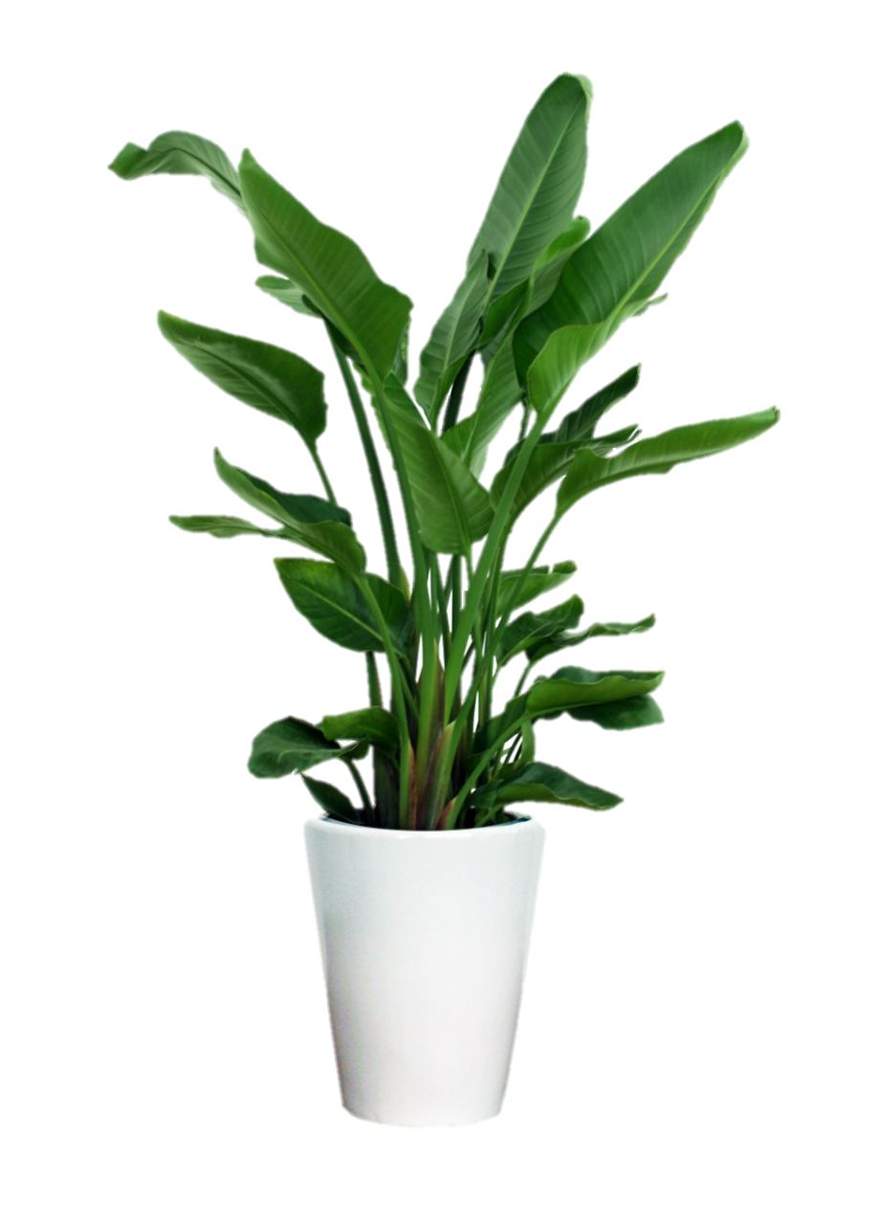
Parent Square/Remind Communication
~ If you are not receiving phone blasts, emails or texts from Wickman or the Chino Valley School District please contact the office.
Sign up for remind
text @3dffce to the number 81010

Slide 23
PTO Membership
PTO Membership Drive- Now
(Link is on the front page of our wickman website.
Volunteers are always appreciated.

Slide 26
Here’s to a great school year! We are in this together!

